Slide 1

Predict Customer Personality to boost marketing campaign by using Machine Learning
Created by:
Muhammad Cikal Merdeka
Email : mcikalmerdeka@gmail.com
LinkedIn : linkedin.com/in/mcikalmerdeka
Github : github.com/mcikalmerdeka
Dedicated entry-level data scientist with analytical and experimental background of Physics. My graduation 2023, a pivotal year marked by significant advancements in artificial intelligence with the introduction of GPT-4 and other generative AI models, has fueled my curiosity and excitement to delve into the field of data. I have comprehensive grasp of data science methodology from business understanding to modelling process with proficiency in Python, SQL, Tableau, Power BI, Looker Studio and other tools related to data analytics workflow from several coursework and bootcamps.

Slide 2
Data Cleaning & Preprocessing
Drop Unnecessary/Unrelated Columns
Some columns (not all) in the dataset that have lost their importance as an individual column will be dropped since their information already stored in the new engineered column (as explained in Task 1).
These columns also doesn’t store related information to our model and keeping them will just increase the dimension.
Columns that will be dropped are :
Unnamed: 0
ID
Year_Birth
Marital_Status
Dt_Customer
For more details, you can view the Jupyter notebook here.

Slide 3
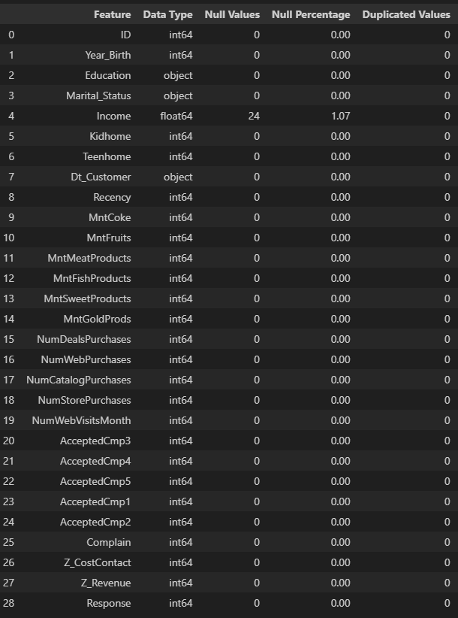
Data Cleaning & Preprocessing
Identifying Missing and Duplicated Values
Income column have a small percentage missing values, we will handle that by imputation with median values considering the positive skewed distribution of the values.
No duplicated values in this dataset.
For more details, you can view the Jupyter notebook here.

Slide 4
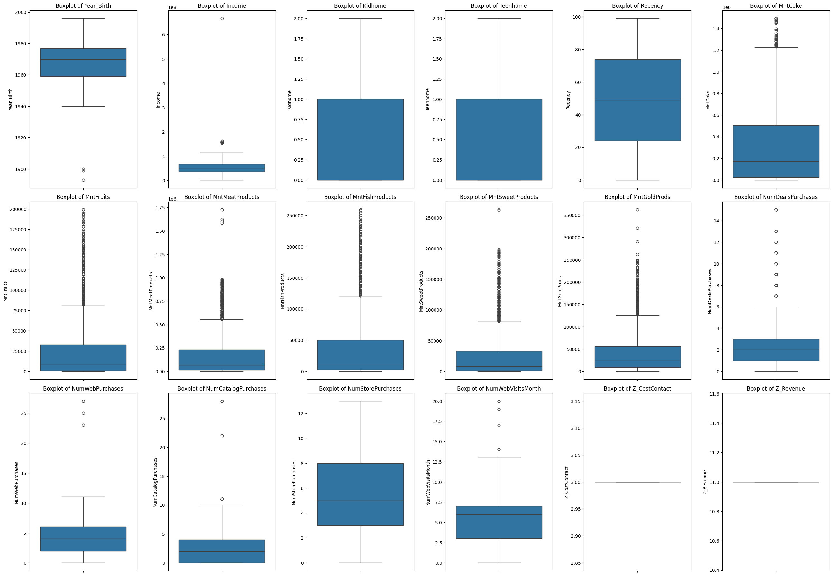
Data Cleaning & Preprocessing
Outliers Handling
Handling outliers with z-score method to columns that have really extreme values (not applied to all columns). Columns that will be handled are : Year_Birth, Income, MntMeatProducts, MntSweetProducts, NumWebPurchases, NumCatalogPurchases
Rows before removing outliers: 2240
Rows after removing outliers: 1861

Slide 5
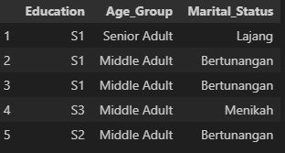
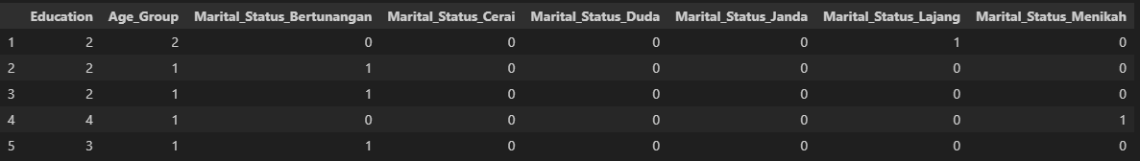
Data Cleaning & Preprocessing
Feature Encoding
There are 3 categorical column that will be encoded based on their data type.
Education : Ordinal type → Label encoding
Age_Group : Ordinal type → Label encoding
Marital_Status : Nominal type → One-hot encoding
Before Encoding
After Encoding

Slide 6

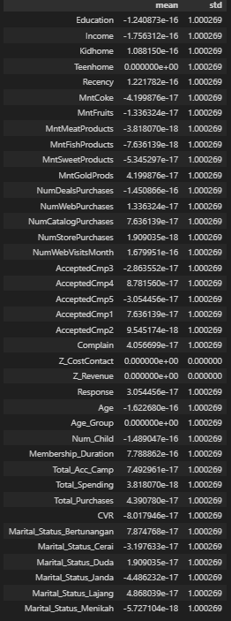
Data Cleaning & Preprocessing
Feature Scaling
After we have all the values in numerical form, we need to transform (scale) the values to ensure fair calculations, especially when we will use distance-based algorithms like K-means clustering.
We use standardization for scaling method to ensure that all columns have mean of 0 and standard deviation of 1.
After Scaling

